Slide 1

RNAi
Specific gene suppression in mammal cells using a DNA template.

Slide 2
RNAi Overview
Introduction to RNAi
Experimental Goals
Techniques Used
Experimental Results
Discussion

Slide 3
RNAi
RNA interference
  Small interfering RNA (double stranded) that inhibits complementary mRNA.
  In general, RNAi suppresses specific proteins.
  Works indirectly by activating the mRNA cutting “Dicer”, a RNase III enzyme.
  Related to gene therapy and antisense therapy

Slide 4
Experimental Goals
A DNA Vector-Based RNAi Technology to Suppress Gene Expression in Mammalian Cells
Testing the efficiency of a DNA template to create the RNAi suppression.
Testing RNAi specificity and variation in suppression efficiency for different proteins and multiple human cell lines.
Notes:
Mitochondria,

Slide 5
Techniques Used
Plasmid Construction
Cell Culture and Transfection
Immunofluorescence Microscopy
Western Blotting
Notes:
Mitochondria,

Slide 6
Plasmid Construction
Different genes were cloned into plasmids for detection and suppression:
Immunofluorescence genes:
- green fluorescent protein (gfp)
    HA-ERK-5
And other gene types to test suppression:
- lamin A/C
  - lamin B
- cyclin-dependent kinase-2 (cdk-2)
- DNA methyltransferase-1 (dnmt-1)
Notes:
Mitochondria,

Slide 7
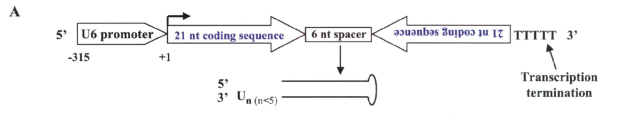
siRNA produced
A 21-nucleotide coding sequence was used to create siRNA loops for suppressing lamin A/C, cdk-2, and dnmt-1.
The loops triggers the action of Dicer, a RNase III endonuclease, to act upon the mRNA of the matching sequence.

Slide 8
Cell Culture and Transfection
The Calcium-Phosphate method was used to get the cells to uptake the DNA.
Each cell group received in excess two plasmids useful for immunodetection, for example one containing gfp, and one containing HA-ERK-5.
For the most part, each plasmid contained only a single gene insert.
Notes:
Mitochondria,

Slide 9
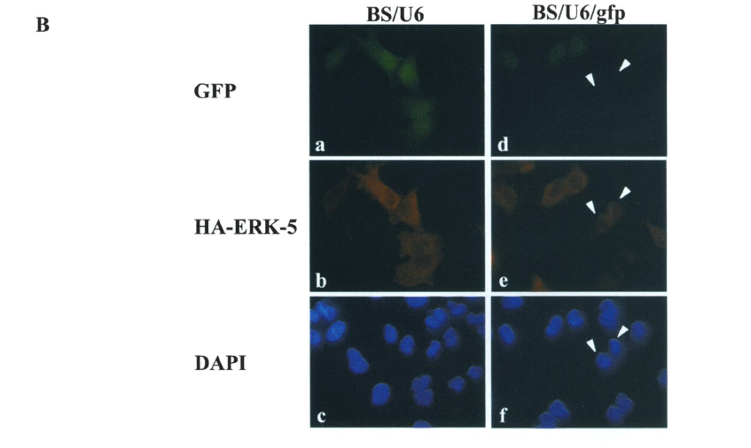
Immunofluorescence Microscopy
DAPI is a general cell-coating stain that affects all cells equally.
Antibodies for the fluorescent proteins were used to detect the expression of the HA-ERK-5 and gfp proteins.
Notes:
Mitochondria,

Slide 10
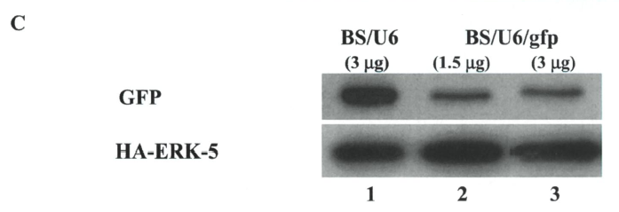
Western Blotting
The transfected cells were lysed and the proteins were purified by centrifugation @ 13,000 gs.
The Bradford Procedure was performed to determine protein concentration.
Gel electrophoresis was used to separate the proteins by mass.
Anti-GFP and Anti-HA-ERK-5 antibodies were used to show the amount of expression of those proteins.

Slide 11
Experimental Results
Gene Suppression
Protein Specificity
Suppression effectiveness on different protein types
Variation Across Cell Lines
Notes:
Mitochondria,

Slide 12
Immunofluorescence of Gene Suppression
The presence of the red HA-ERK-5 and absence of the green gfp shows the suppressing action of a gfp siRNA.
Notes:
Mitochondria,

Slide 13
Western Blot of Protein Suppression
The anti-body staining of the western membrane showed the lowered expression of the GFP protein even as the HA-ERK-5 protein remained strongly expressed.

Slide 14
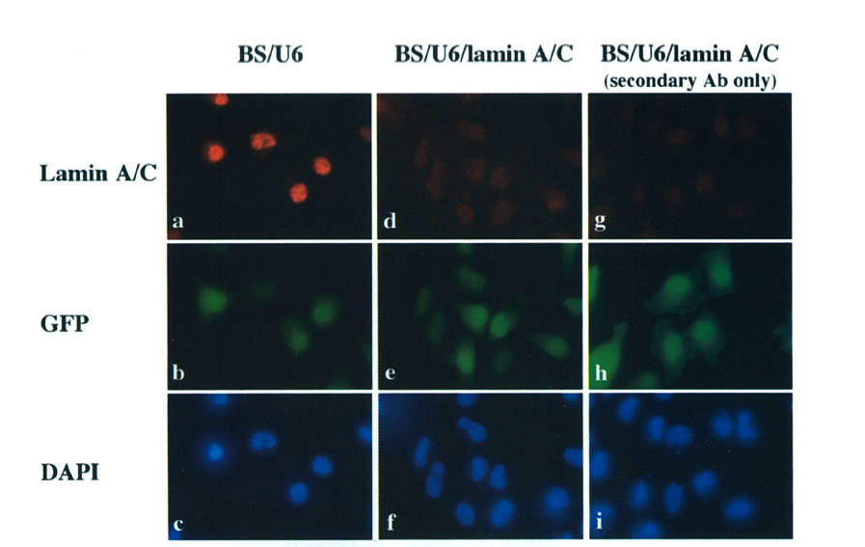
Specificity for Lamin A/C
The red fluoresence shows the expression of Lamin A/C, and thus the absence of red in the second column shows RNAi suppression. The third column shows the amount of basic background fluorescence from the antibodies alone.

Slide 15
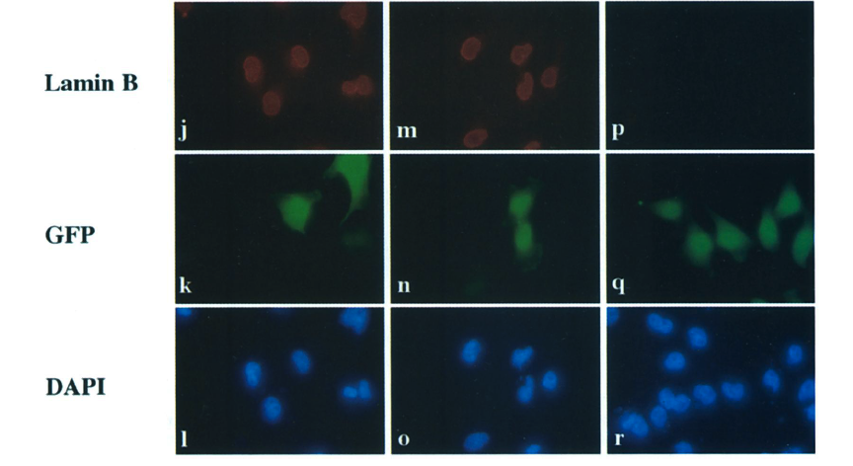
No Specificity for Lamin B
Lamin B, on the other hand, was shown to have no difference in expression in the presence of the RNAi, showing that even having a very similar protein cannot overcome the specificity of the RNAi mechanism.

Slide 16
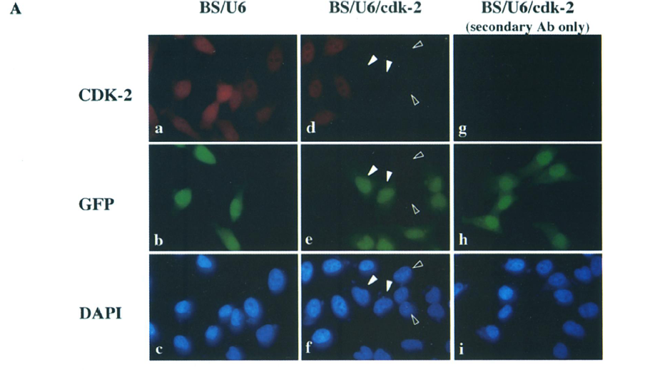
Suppression of cdk-2 protein
The expression of the cell cycle protein cdk-2 can also be suppressed by a cdk-2 RNAi loop.

Slide 17
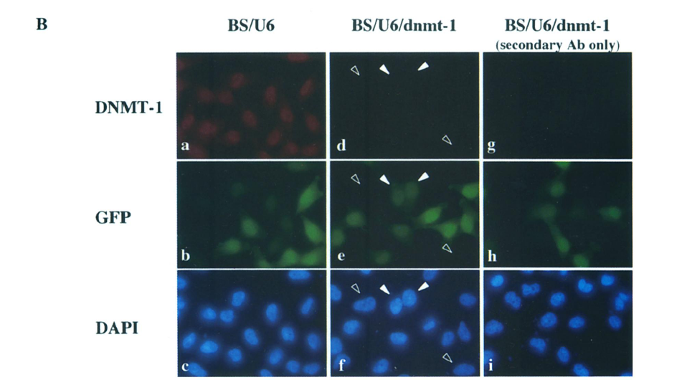
Suppression of dnmt-1 protein
The DNA methyltransferase dnmt-1 is also able to be expressed by its own dnmt-1 specific siRNA loop.

Slide 18
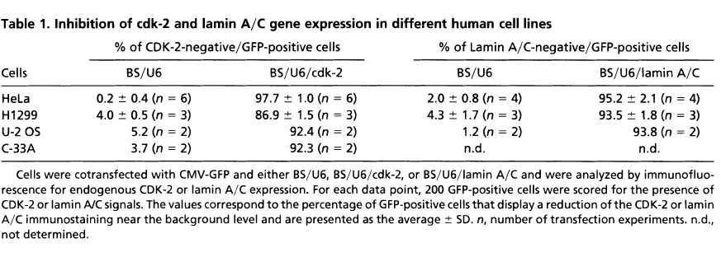
Variation Across Cell Lines
Cell lines tested:
HeLa (cervical carcinoma)
H1299 (nonsmall cell lung carcinoma)
U-2 OS (osteosarcoma)
C-33A (human papilloma virus negative cervical carcinoma)

Slide 19
Discussion
Success of the DNA vector-based approach:
  Highly suppressive
Specificity of the mechanism:
  Distinguishes between two homologous proteins
General usefulness of the technique:
  Consistent suppression of different protein types
  Only minor variation across different cell lines
Notes:
Mitochondria,

Slide 20
Questions?
Sui, G., et al, A DNA Vector-Based RNAi Technology to Suppress Gene Expression in Mammalian Cells, P.N.A.S. 99, No. 8:5515-5520, 2002
All images and the table were taken from the paper itself.

